Slide 1
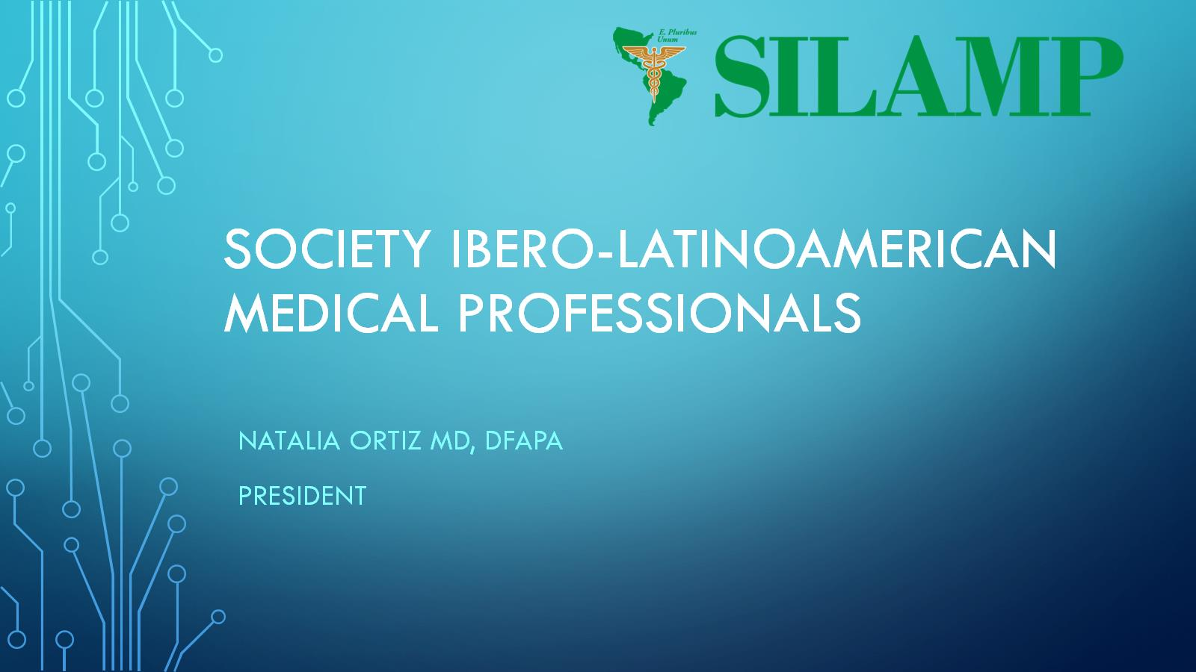
Society Ibero-Latinoamerican Medical Professionals

Slide 2
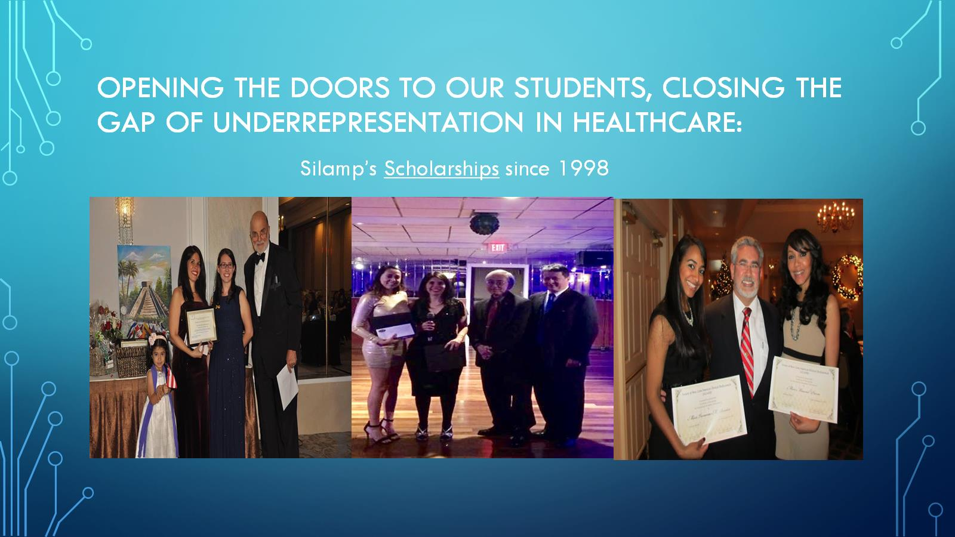
Opening the doors to our students, Closing the Gap of underrepresentation in Healthcare:

Slide 3
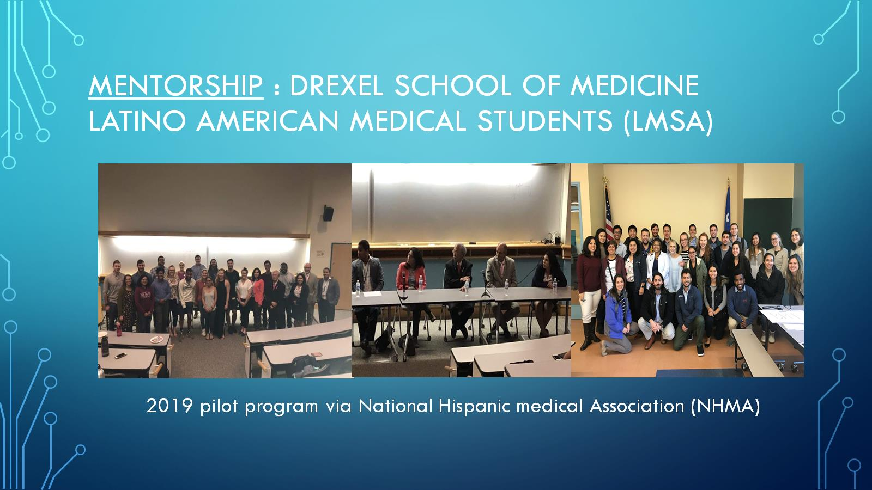
Mentorship : drexel school of medicine latino american medical students (LMSA)

Slide 4
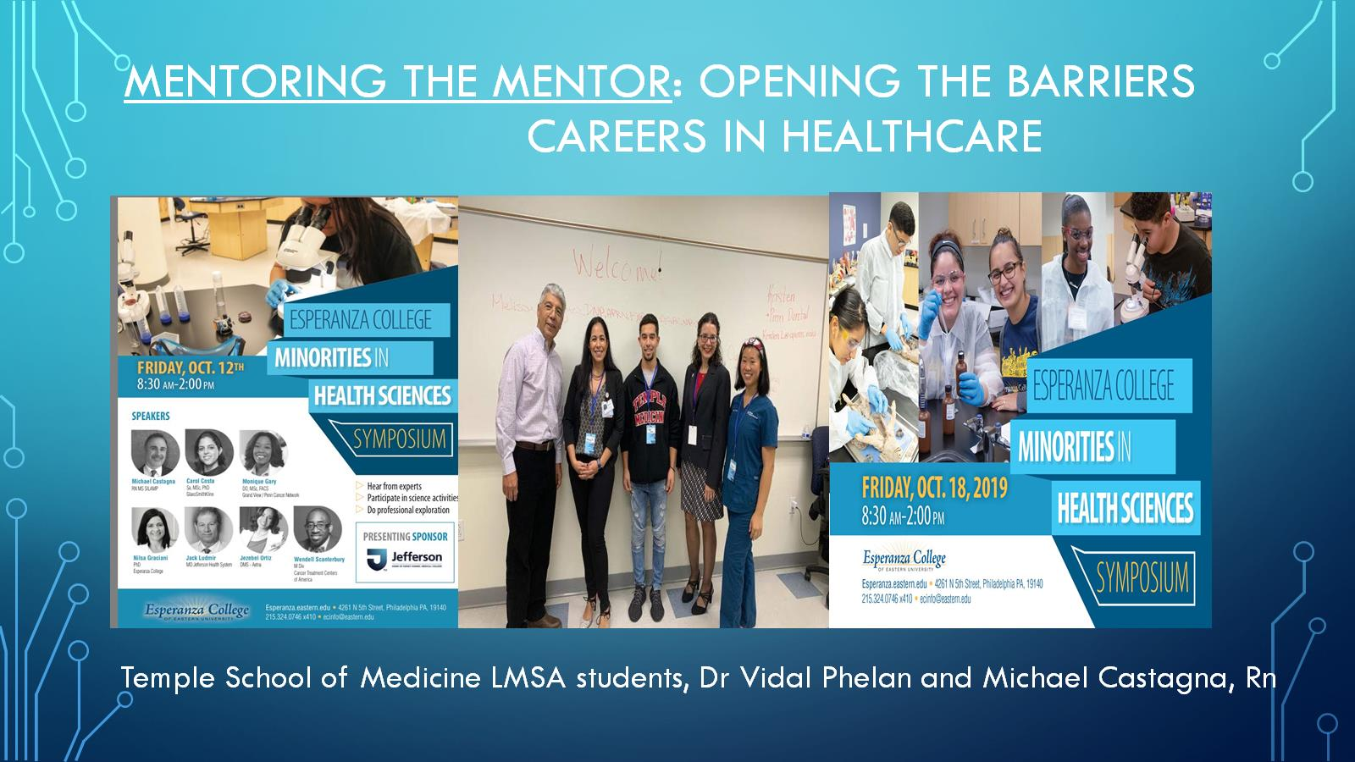
Mentoring the mentor: opening the barriers careers in healthcare

Slide 5
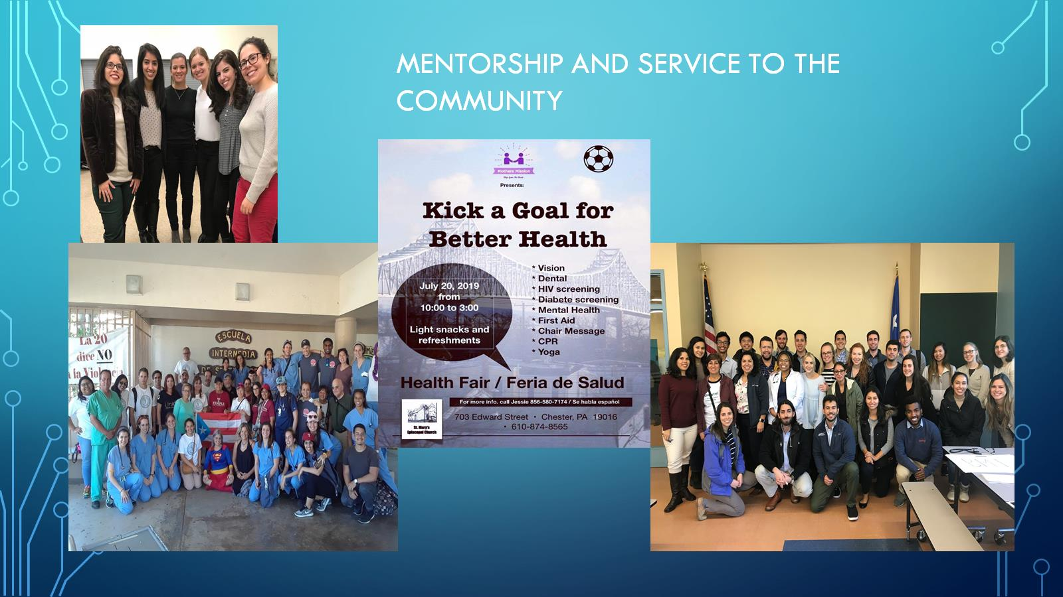

Slide 6
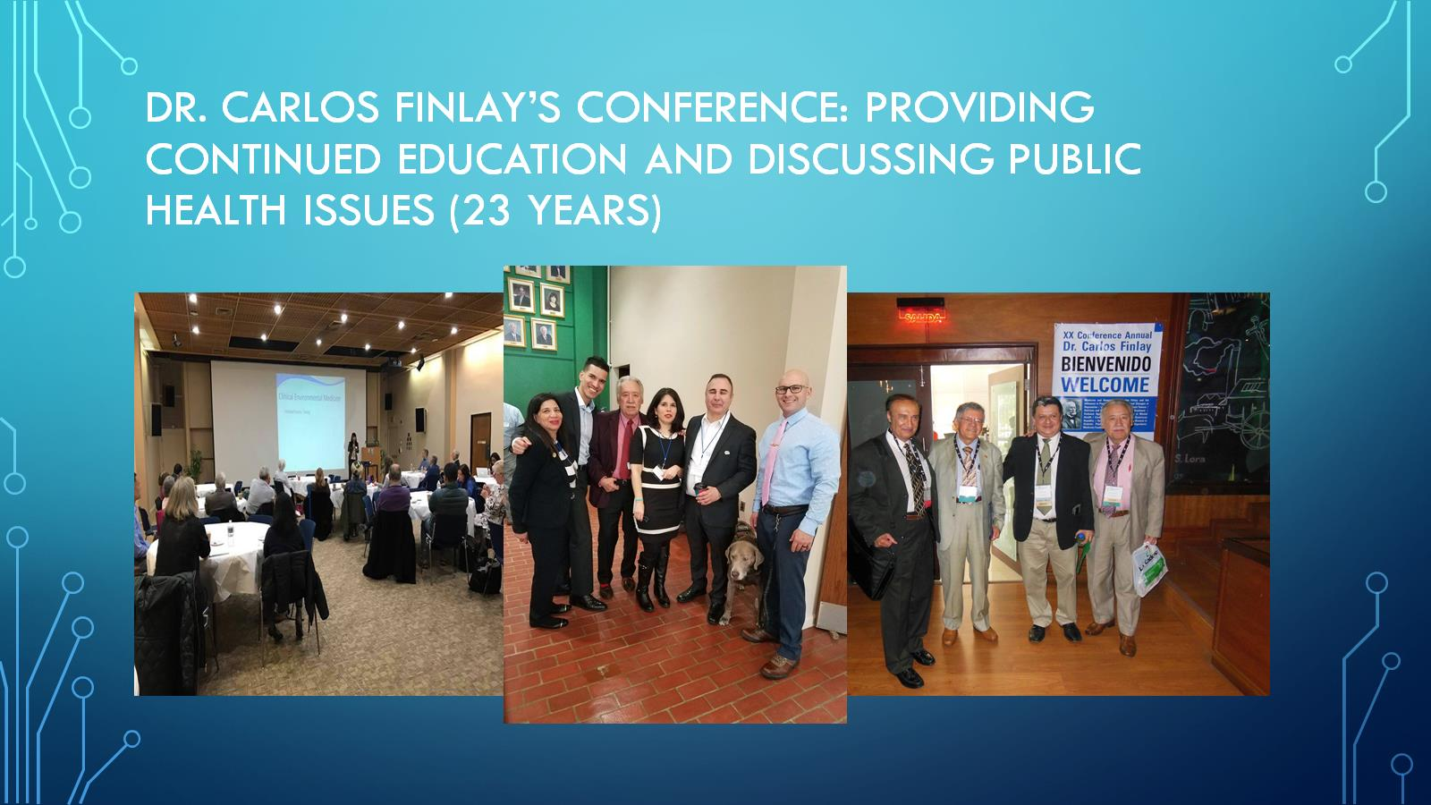
Dr. Carlos Finlay’s Conference: PROVIDING CONTINUED EDUCATION AND DISCUSSING PUBLIC HEALTH ISSUES (23 years)

Slide 7
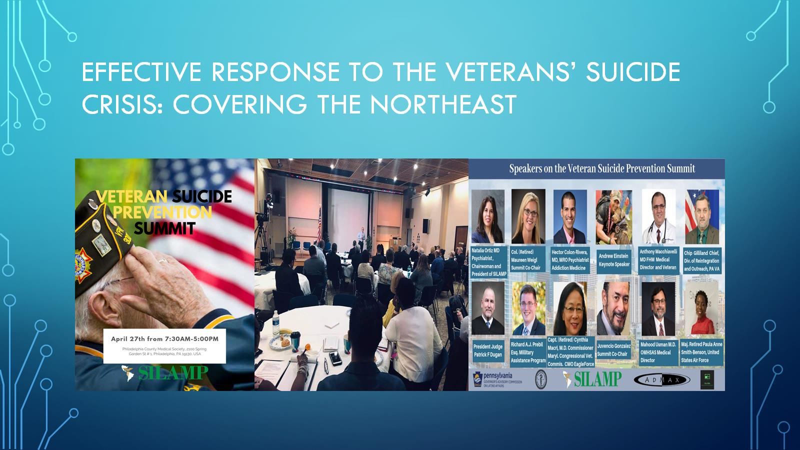
Effective response to the veterans’ suicide crisis: covering the northeast

Slide 8
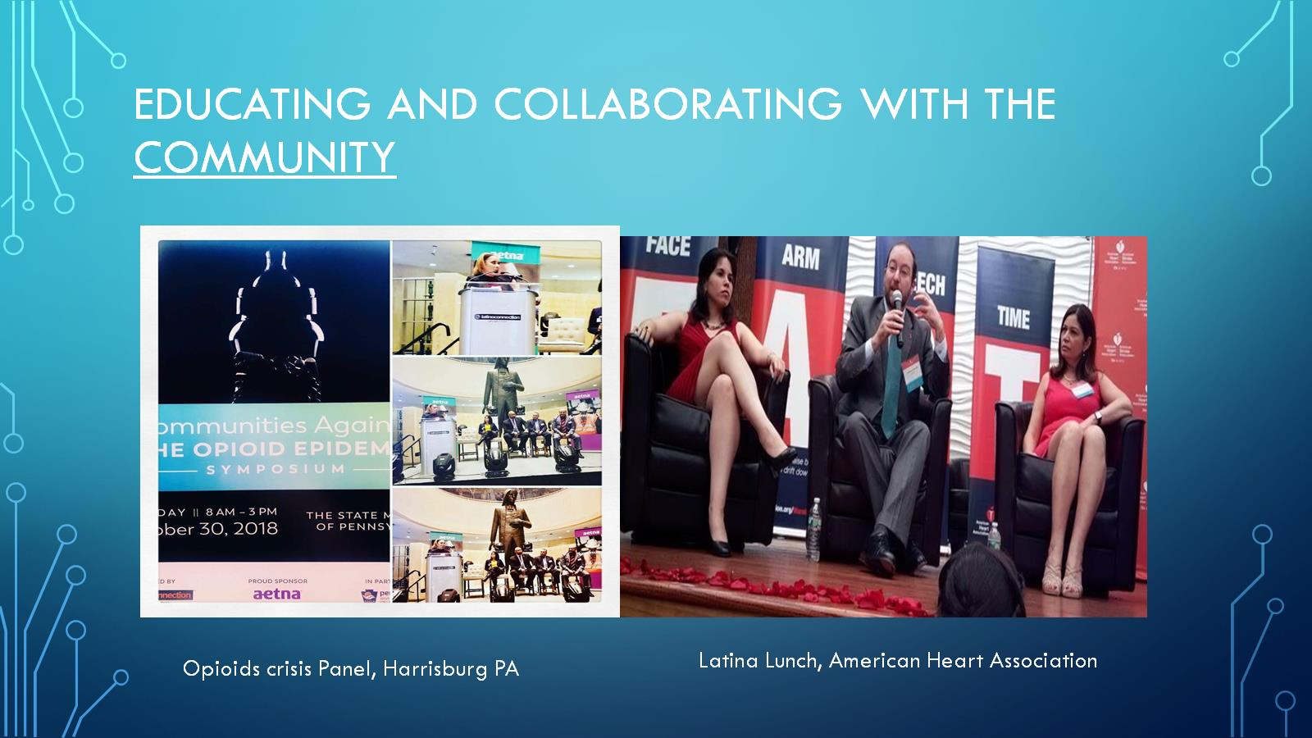
Educating and collaborating with the community

Slide 9
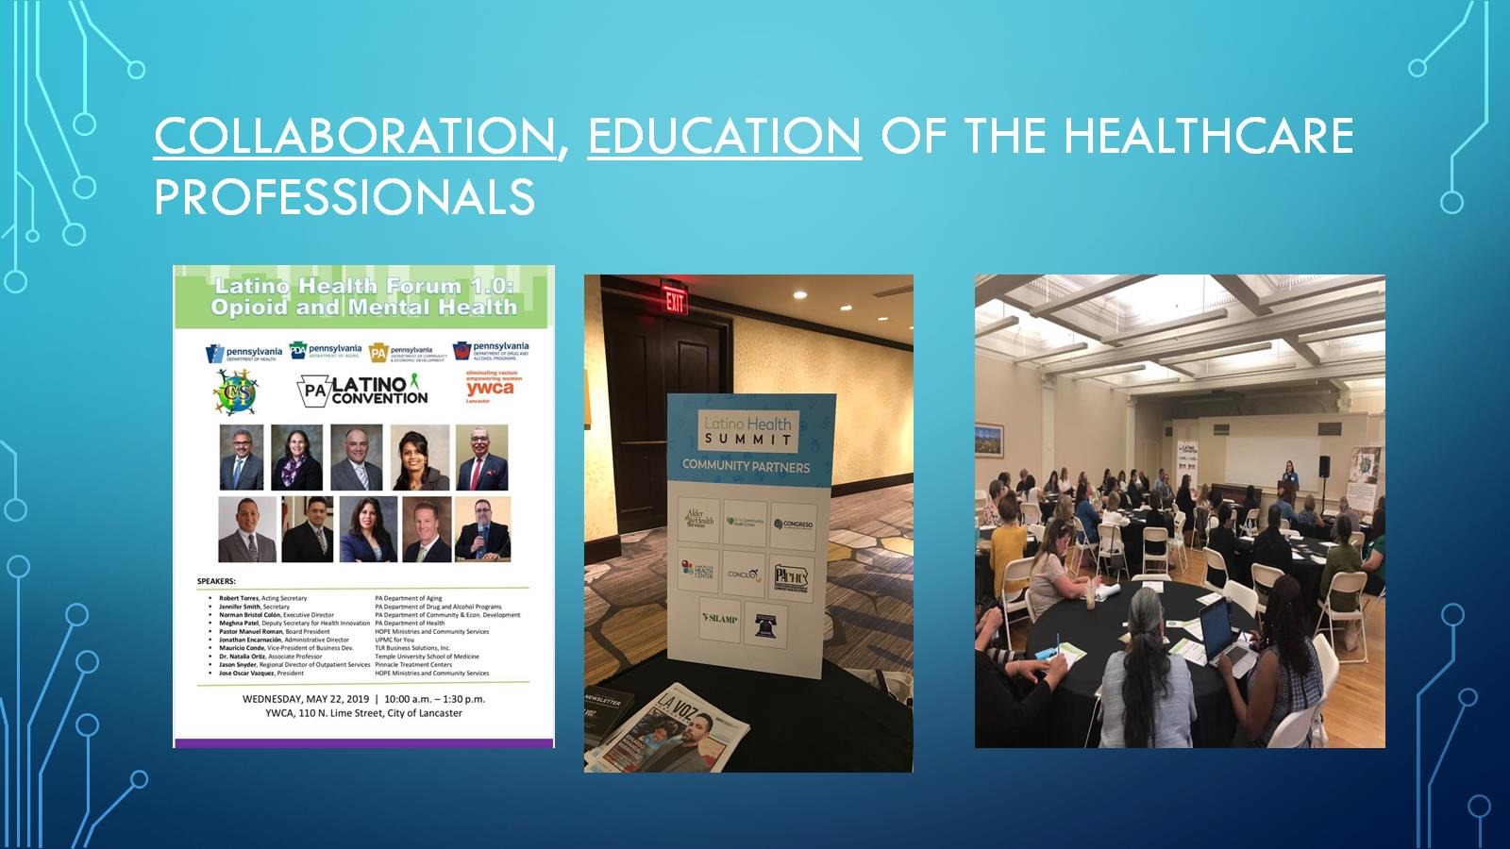
Collaboration, Education of the healthcare professionals

Slide 10
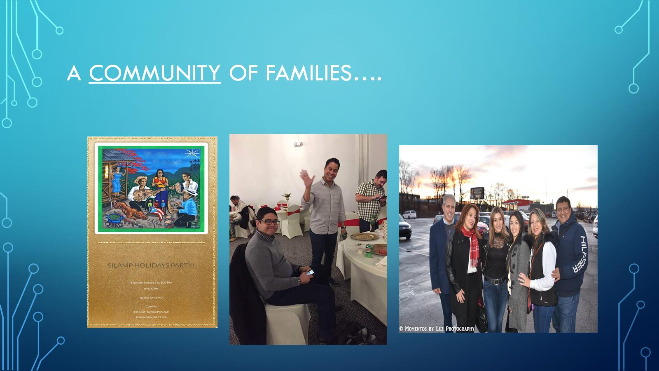
A Community of families….

Slide 11
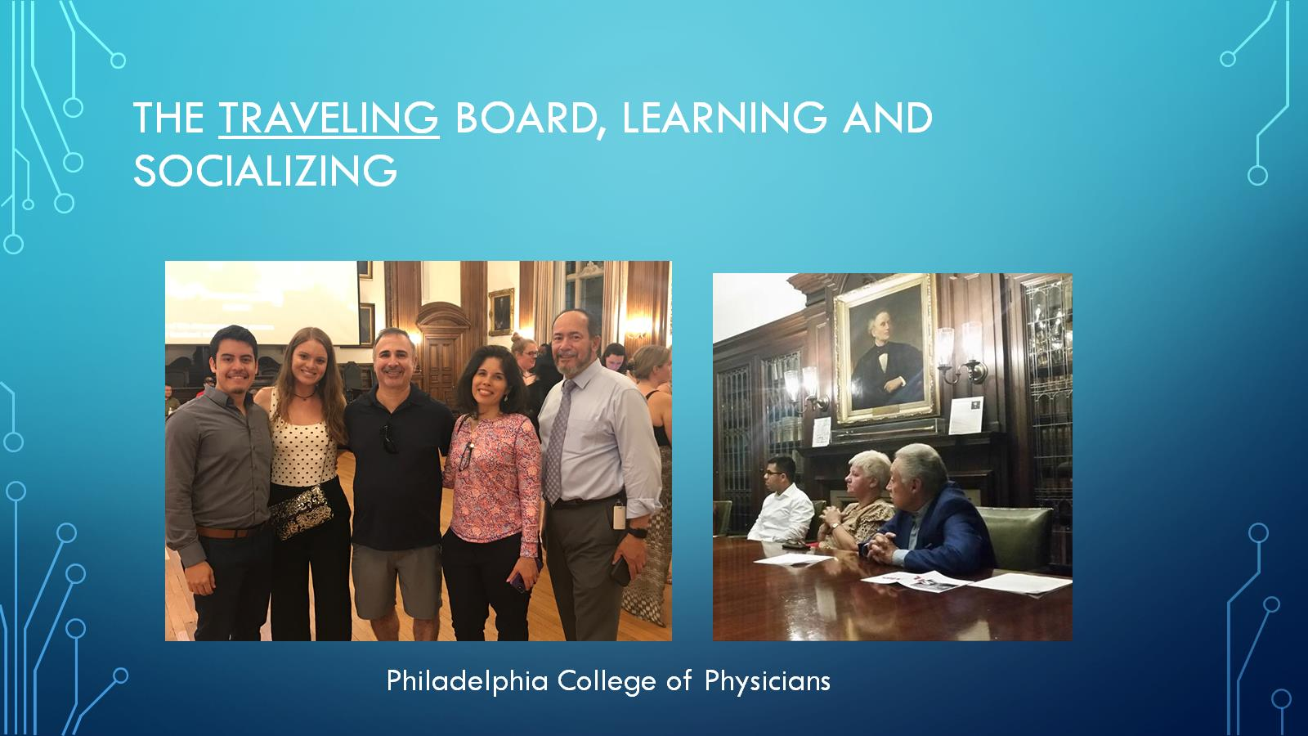
The traveling Board, Learning and socializing

Slide 12
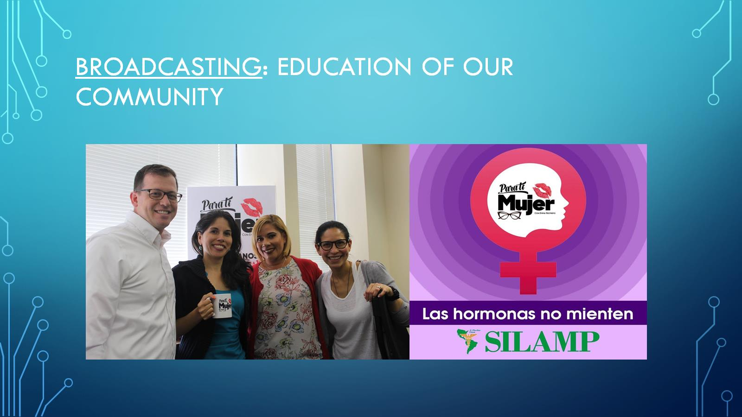
Broadcasting: education of our community

Slide 13
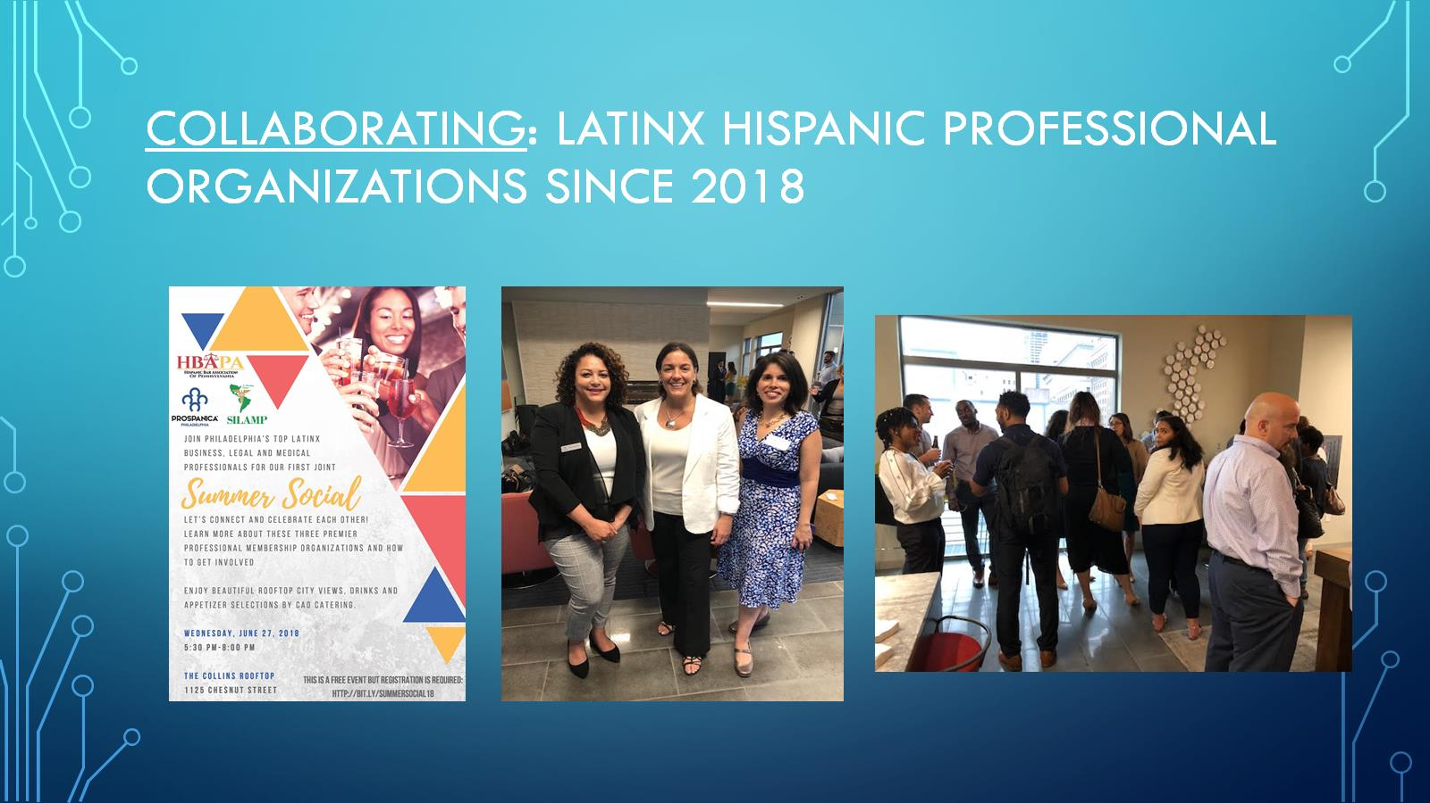
Collaborating: latinx hispanic professional organizations since 2018

Slide 14
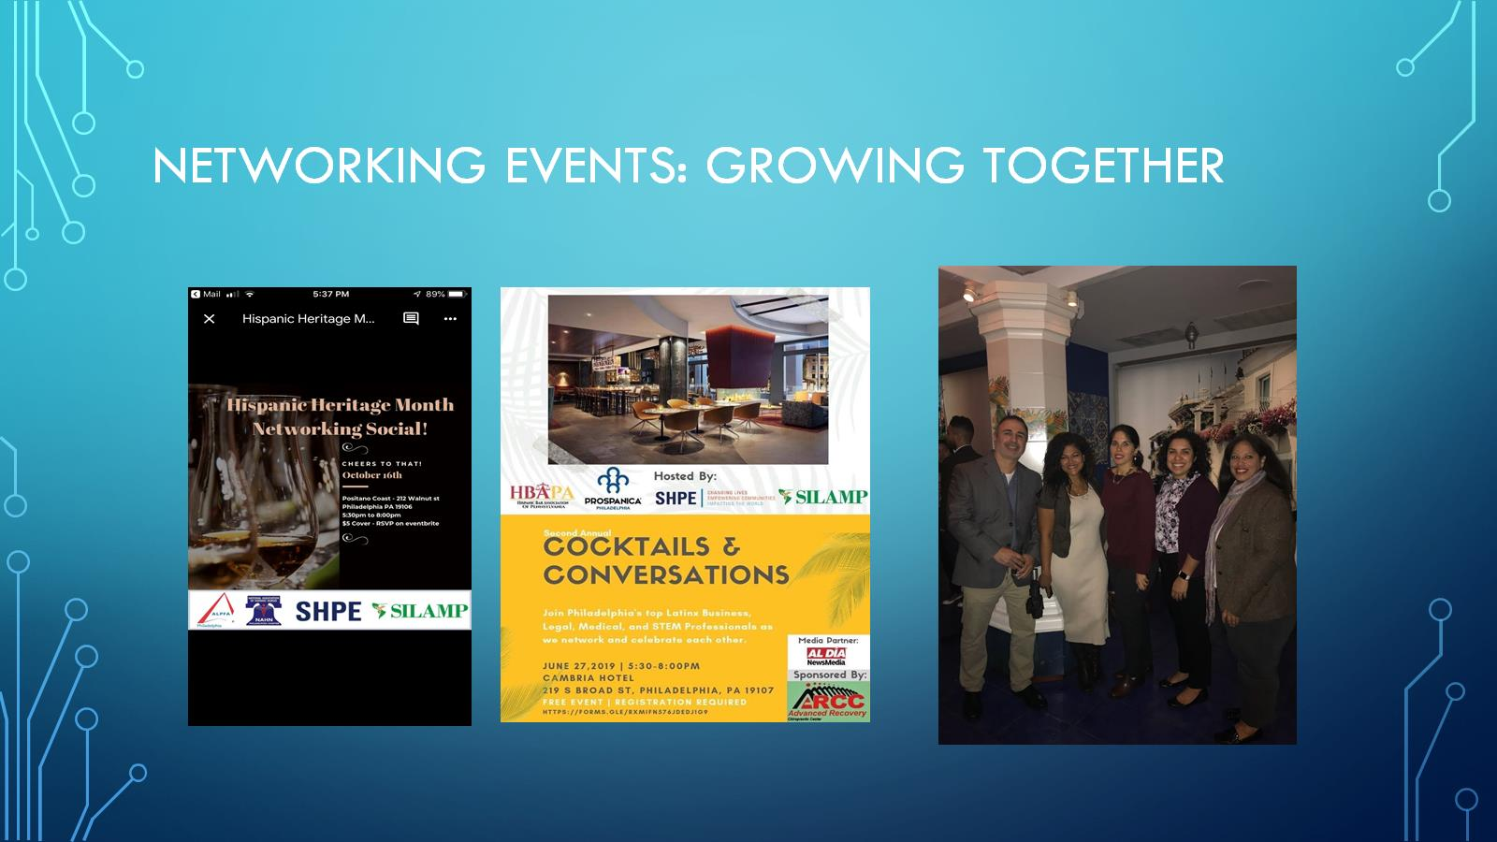
Networking events: growing together

Slide 15
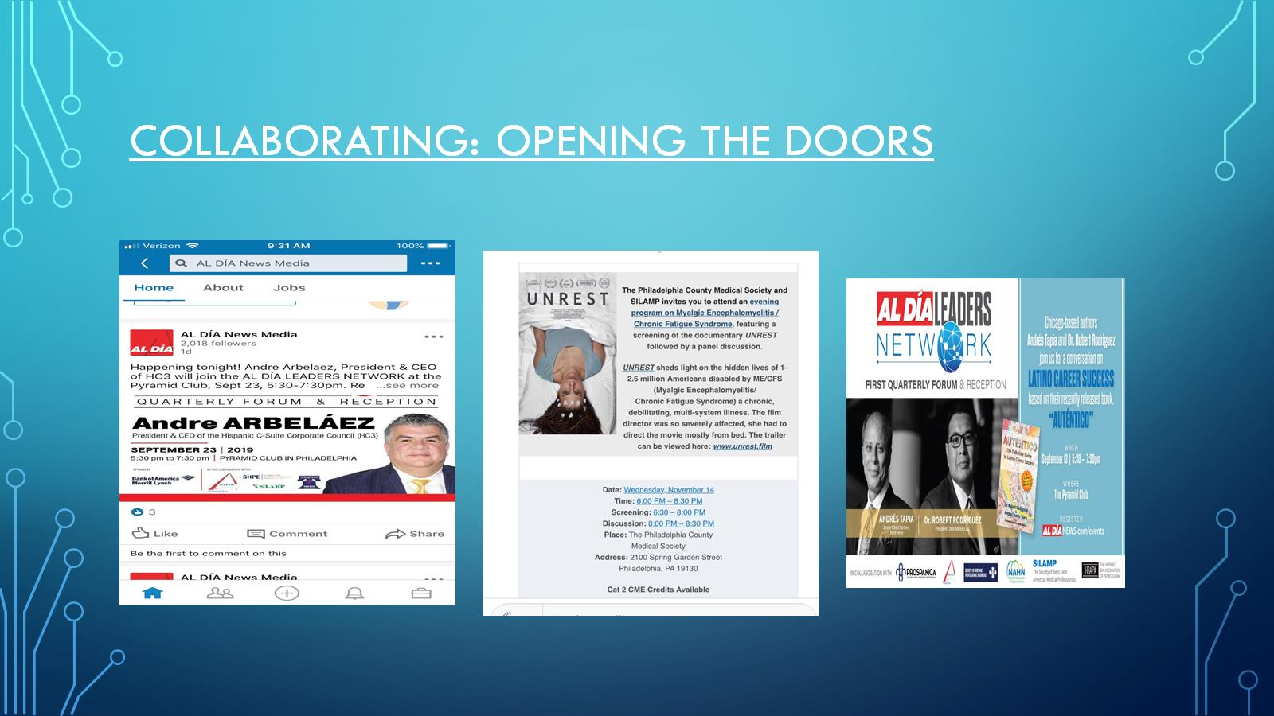
Collaborating: opening the doors

Slide 16
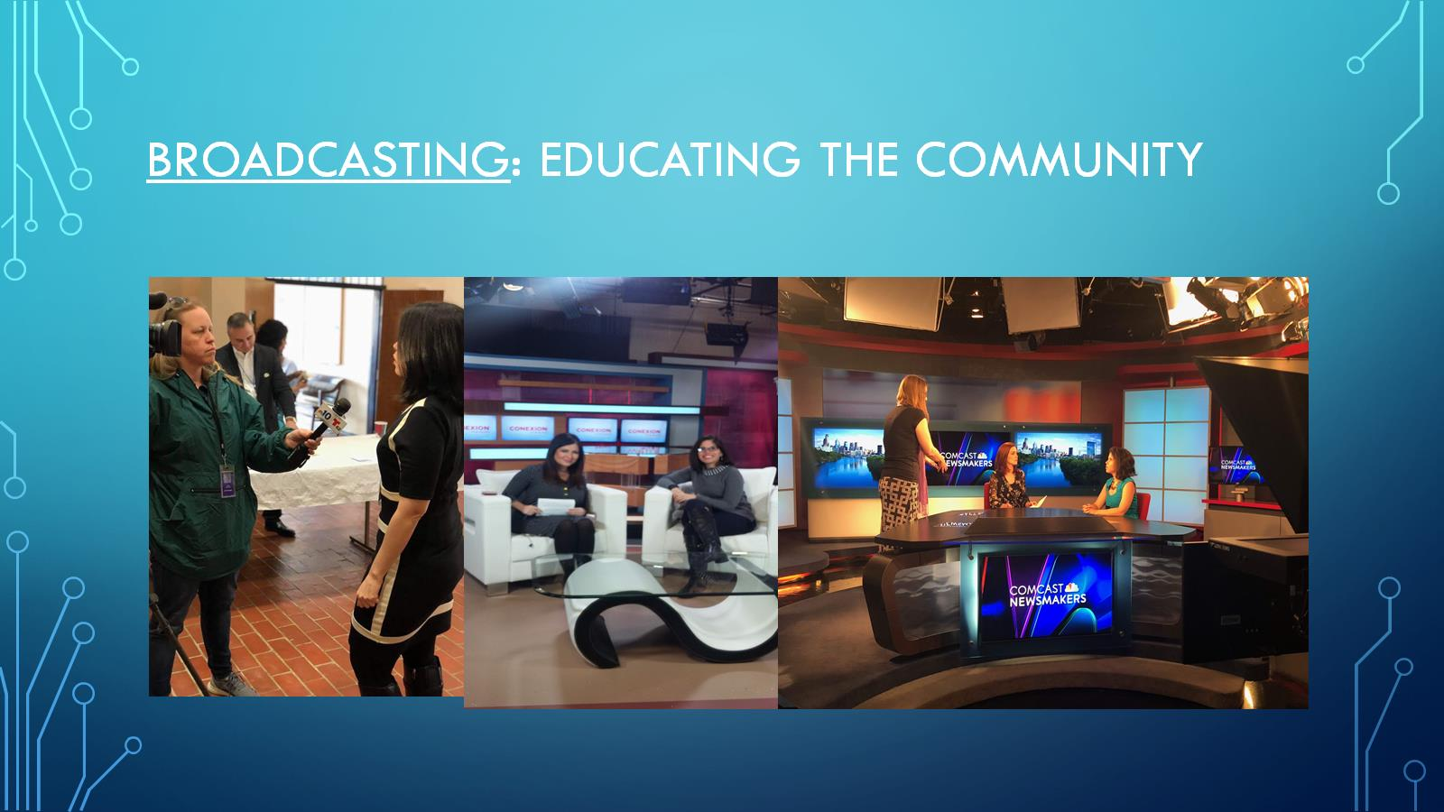
Broadcasting: Educating the community

Slide 17
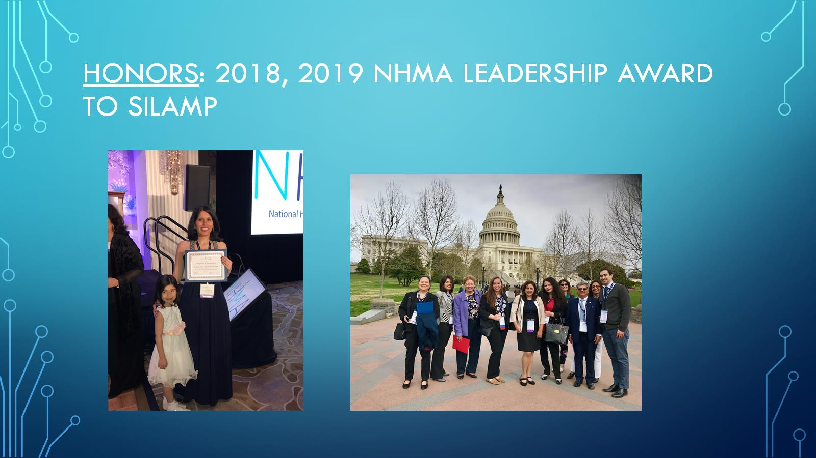
Honors: 2018, 2019 NHMA Leadership award to silamp

Slide 18
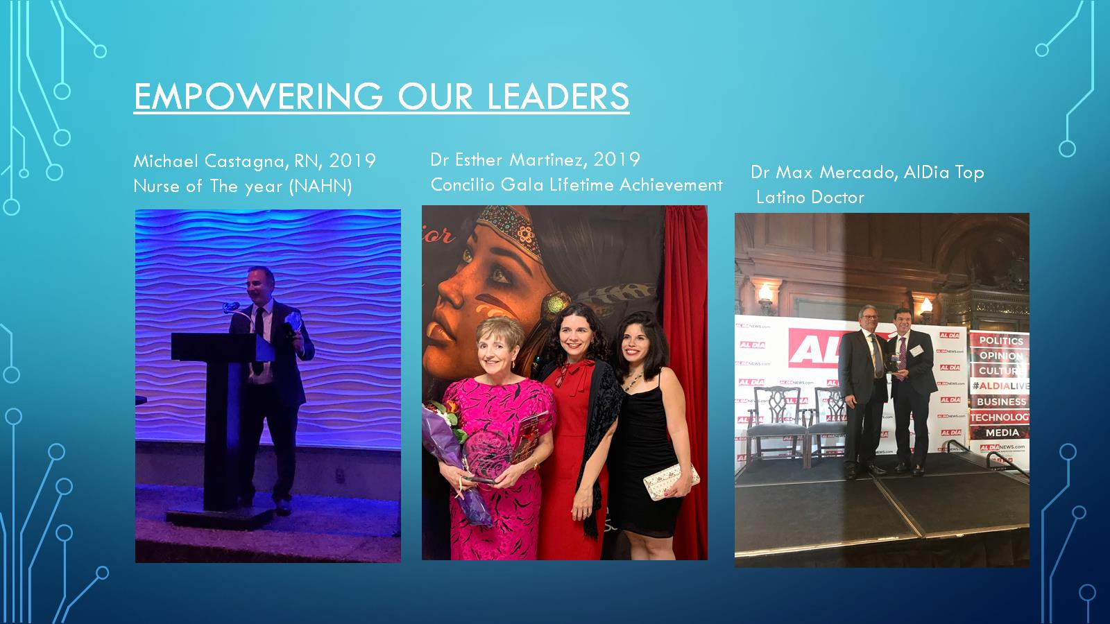
Empowering our leaders

Slide 19
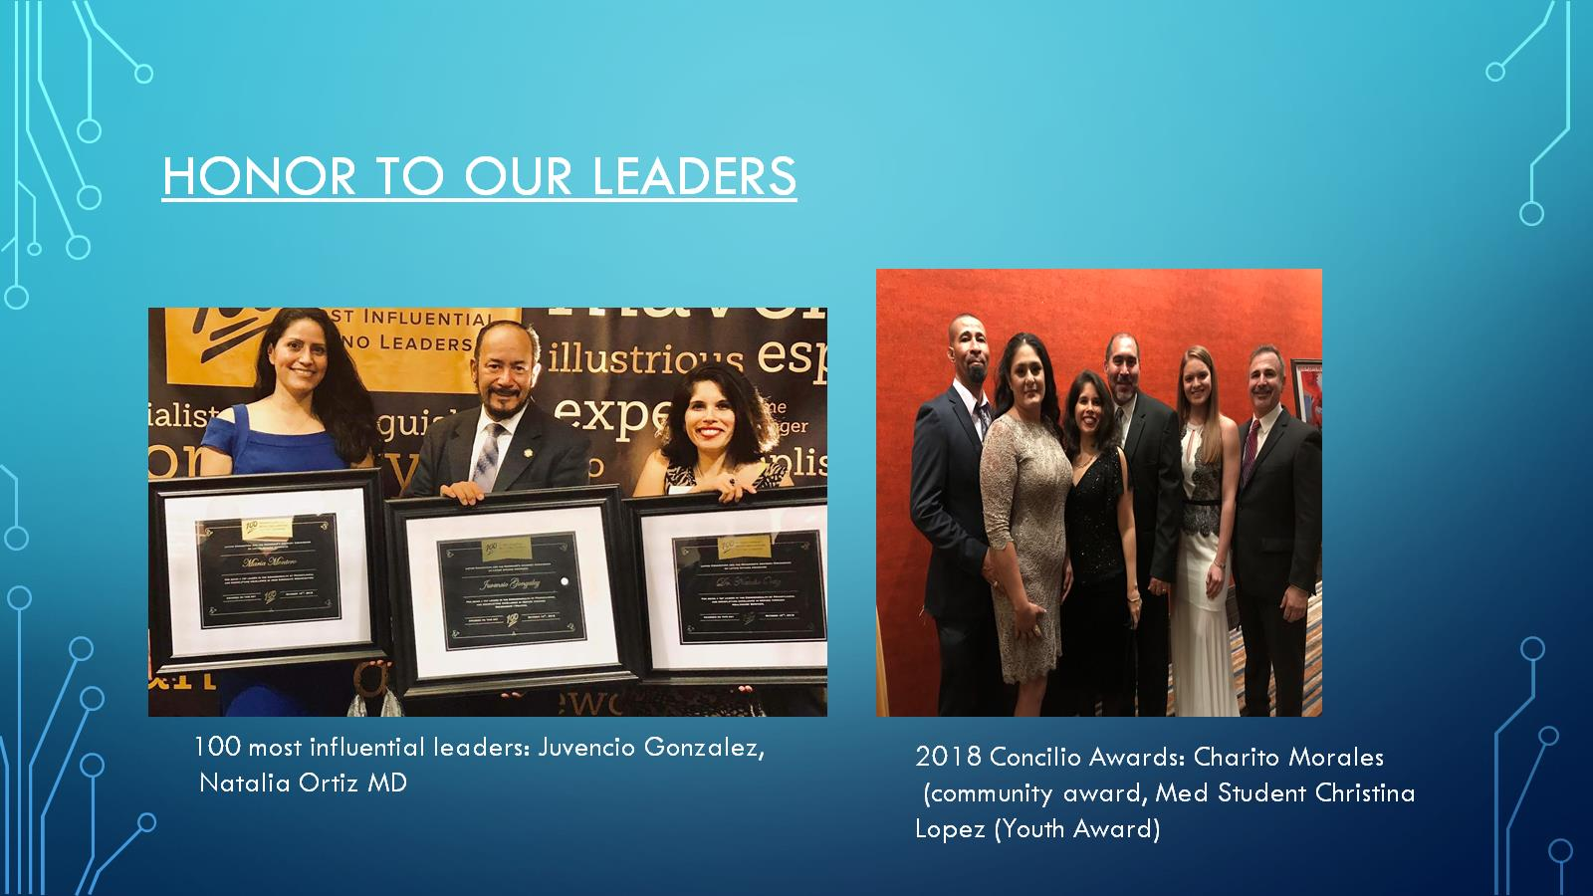
Honor to our leaders

Slide 20
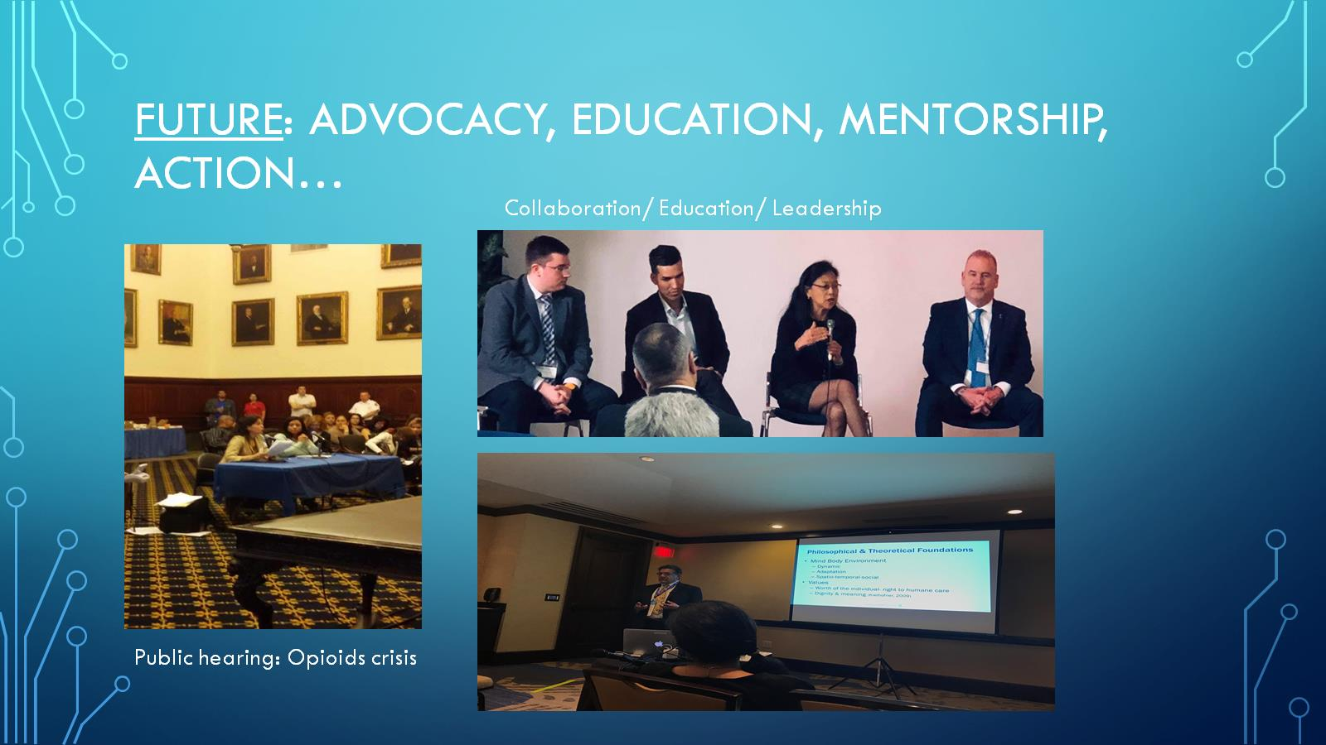
Future: advocacy, education, mentorship, action…

